Slide 1

INT233: Unit I DATA VISUALIZATION FUNDAMENTALS
Prepared by:
Amanpal Singh Rayat

Slide 2
Table of contents
Basics of Data visualization
Data types
Exploratory Vs Explanatory visualizations
Design principles for charts and graphs
Value of Visualization
Data and Image Models
Common tools for creating data visualizations (Excel vs SPSS vs R vs Tableau)

Slide 3
1. Introduction to Data Visualization
Definition: Data visualization is the graphical representation of information and data. It uses visual elements such as charts, graphs, and maps to make data more understandable and accessible.
Importance in Data Analysis:
Facilitates understanding complex data.
Aids in identifying patterns and trends.
Enhances decision-making.

Slide 4
1.1 Basics of Data visualization
In the world of Big Data, data visualization tools and technologies are essential to analyze massive amounts of information and make data-driven decisions.
Our eyes are drawn to colors and patterns. If you’ve ever stared at a massive spreadsheet of data and couldn’t see a trend, you know how much more effective a visualization can be.
Notes:
https://www.tableau.com/learn/articles/data-visualization

Slide 5
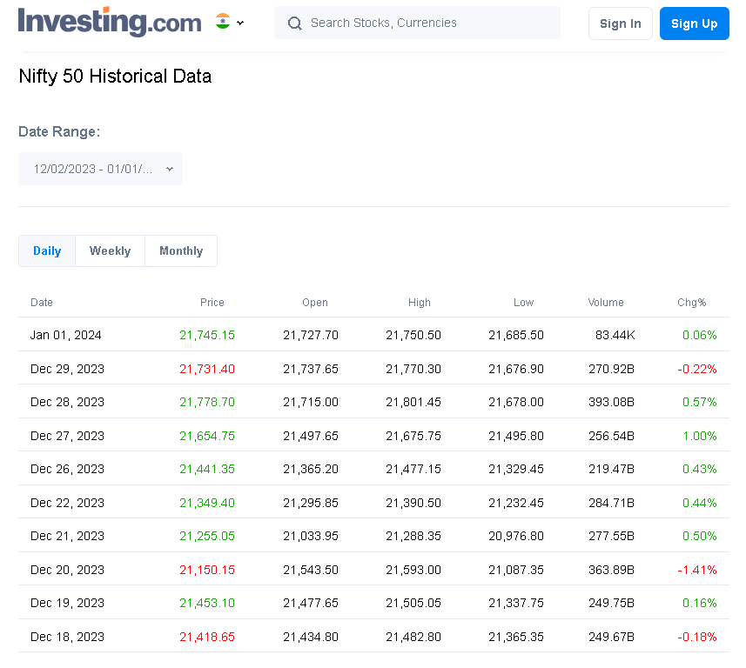
NIFTY50: December 2023 data (Textual)

Slide 6
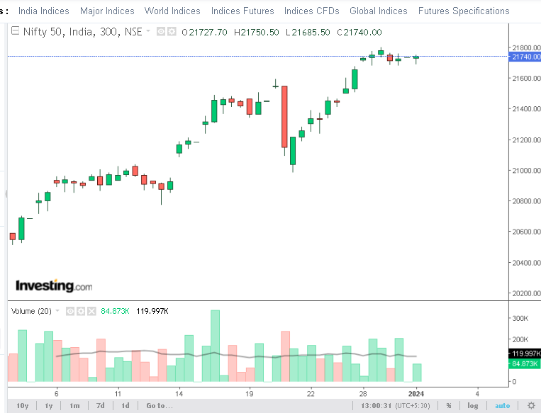
NIFTY50: December 2023 data (Visual)
Reference: https://in.investing.com/indices/s-p-cnx-nifty-chart

Slide 7
1.2 Advantages / Disadvantages of data visualization
Easily sharing information.
Interactively explore opportunities.
Visualize patterns and relationships.
Biased or inaccurate information.
Correlation doesn’t always mean causation.
Core messages can get lost in translation.

Slide 8
Contd…
The better you can convey your points visually, whether in a dashboard or a slide deck, the better you can leverage that information.
The plainest graph could be too boring to catch any notice or it make tell a powerful point.
The most stunning visualization could utterly fail at conveying the right message or it could speak volumes.

Slide 9
1.3 The importance of data visualization
It helps people see, interact with, and better understand data.
Whether simple or complex, the right visualization can bring everyone on the same page, regardless of their level of expertise.
Every STEM field benefits from understanding data, and so do fields in government, finance, marketing, history, consumer goods, service industries, education, sports, and so on.

Slide 10
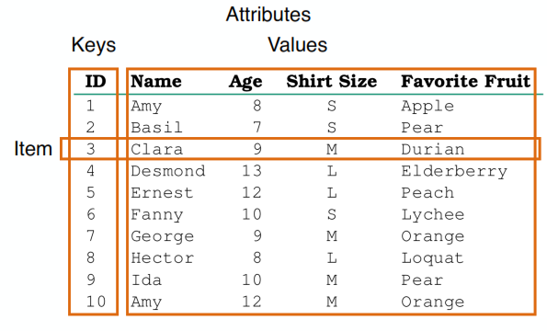
Simple Table
Flat Table
one item per row
each column is attribute
unique (implicit) key
no duplicates
Multidimensional Table
indexing based on multiple keys

Slide 11
2.1 Data types
A data type is an attribute associated with a piece of data that tells a computer system how to interpret its value. Understanding data types ensures that data is collected in the preferred format and the value of each property is as expected. For eg:
Numeric
String
Boolean
Datetime etc.

Slide 12
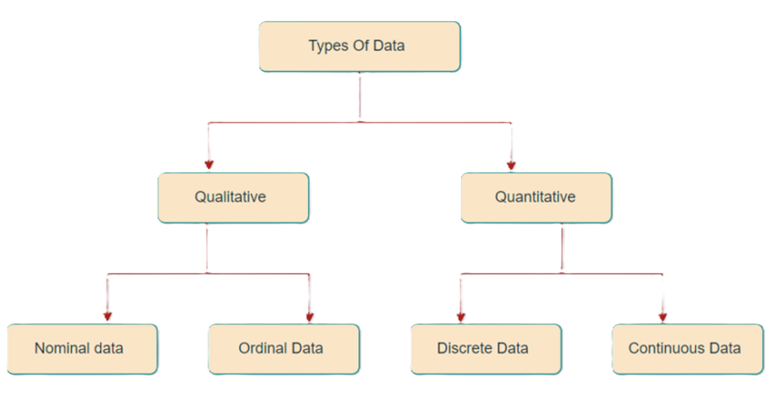
Types of Data
Data that can be expressed in numerical values.
Data that can’t be measured or counted in the form of numbers.
“nomen,” which means “name.”
natural ordering
finite values
divided into smaller levels
Notes:
https://ucdavisdatalab.github.io/workshop_data_viz_principles/principles-of-visual-perception.html

Slide 13
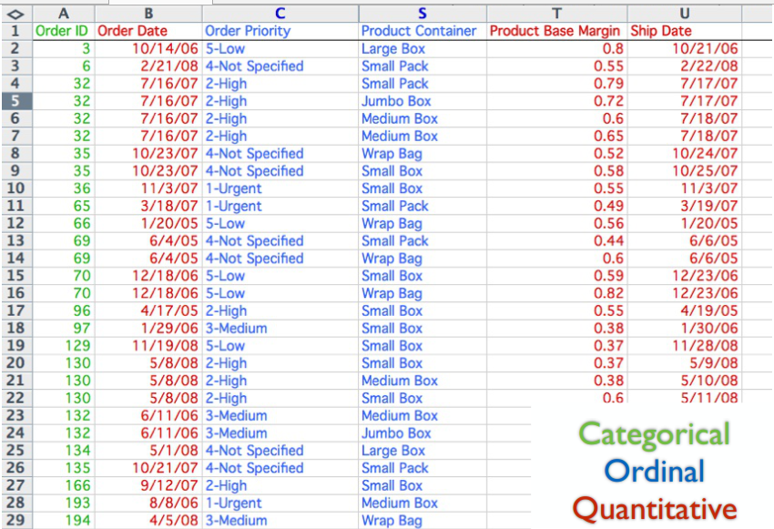

Slide 14
Qualitative / Categorical Data
It is data that can’t be measured or counted in the form of numbers.
These types of data are sorted by category, not by number (known as Categorical Data)
These data consist of audio, images, symbols, or text.
The gender of a person, i.e., male, female, or others, is qualitative data.

Slide 15
Qualitative -> Nominal Data
It is used to label variables without any order or quantitative value.
The name “nominal” comes from the Latin name “nomen,” which means “name.”
With the help of nominal data, we can’t do any numerical tasks or can’t give any order to sort the data.
These data don’t have any meaningful order; their values are distributed into distinct categories.
Notes:
4 Types of Data - Nominal, Ordinal, Discrete, Continuous (mygreatlearning.com)
https://www.mygreatlearning.com/blog/types-of-data/

Slide 16
Examples of Nominal Data
Colour of hair (Blonde, red, Brown, Black, etc.)
Marital status (Single, Widowed, Married)
Nationality (Indian, German, American)
Gender (Male, Female, Others)
Eye Color (Black, Brown, etc.)

Slide 17
Qualitative -> Ordinal Data
Ordinal data have natural ordering where a number is present in some kind of order by their position on the scale.
Used for observation like customer satisfaction, happiness, etc., but we can’t do any arithmetical tasks on them.
Values have some kind of relative position.
Only shows the sequences and cannot use for statistical analysis.
Compared to nominal data, ordinal data have some kind of order that is not present in nominal data.

Slide 18
Examples of Ordinal Data
When companies ask for feedback, on a scale.
Letter grades in the exam (A, B, C, D, etc.)
Ranking of people in a competition (First, Second, Third, etc.)
Economic Status (High, Medium, and Low)
Education Level (Higher, Secondary, Primary)

Slide 19
Nominal vs Ordinal Data
Nominal Data | Ordinal Data
Can’t be quantified, neither they have any intrinsic ordering | Gives some kind of sequential order by their position on the scale
Qualitative data or categorical data | Is said to be “in-between” qualitative data and quantitative data
Can not perform any arithmetical operation | They provide sequence and can assign numbers to ordinal data but cannot perform the arithmetical operation
Nominal data cannot be used to compare with one another | Ordinal data can help to compare one item with another by ranking or ordering
Examples: Eye color, housing style, gender, hair color, religion, marital status, ethnicity, etc | Examples: Economic status, customer satisfaction, education level, letter grades, etc

Slide 20
Quantitative Data
Quantitative data can be expressed in numerical values.
Countable and including statistical data analysis.
Known as Numerical data. It answers the questions like “how much,” “how many,” and “how often.
Can be used for statistical manipulation.
These data can be represented on a wide variety of graphs and charts

Slide 21
Examples of Quantitative Data
Height or weight of a person or object
Room Temperature
Scores and Marks (Ex: 59, 80, 60, etc.)
Time

Slide 22
Quantitative-> Discrete Data
The term discrete means distinct or separate.
The discrete data contain the values that fall under integers or whole numbers.
The discrete data are countable and have finite values; their subdivision is not possible.
These data are represented mainly by a bar graph, number line, or frequency table.

Slide 23
Examples of Discrete Data
Total numbers of students present in a class
Cost of a cell phone
Numbers of employees in a company
The total number of players who participated in a competition
Days in a week

Slide 24
Quantitative-> Continuous Data
Continuous data represents information that can be divided into smaller levels.
The continuous variable can take any value within a range.

Slide 25
Examples of Continuous Data
Height of a person
Speed of a vehicle
Market share price

Slide 26
Discrete Data vs Continuous Data
Discrete Data | Continuous Data
Countable and finite; they are whole numbers or integers | Measurable; they are in the form of fractions or decimal
Represented mainly by bar graphs | Represented in the form of a histogram
The values cannot be divided into subdivisions into smaller pieces | The values can be divided into subdivisions into smaller pieces
Have spaces between the values | Are in the form of a continuous sequence
Examples: Total students in a class, number of days in a week, size of a shoe, etc | Example: Temperature of room, the weight of a person, length of an object, etc

Slide 27
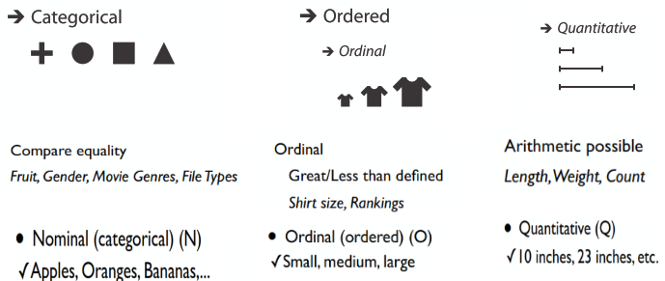
Attribute Types
Notes:
http://web.cse.ohio-state.edu/~machiraju.1/teaching/CSE5544/ClassLectures/PDF/Lecture-3-1.pdf

Slide 28
3 Exploratory vs. Explanatory Visualizations
Exploratory Visualizations:
Aimed at discovering patterns.
Often used during data analysis.
allows the user to interact with the visualizations to uncover their own findings.
Explanatory Visualizations:
Designed to communicate insights.
Clear and focused on a specific message.
is more prescriptive and guides the user to specific findings.
Notes:
https://www.thedataschool.co.uk/dan-wade/exploratory_vs_explanatory_analysis/

Slide 29
Exploratory: You’re exploring the data to identify trends and outliers.
Explanatory analysis is the step beyond exploratory. Instead of explaining what happened, you’re more focused on how and why it happened and what should happen next and, in most cases, communicating that to the necessary decision-makers and stakeholders.
Notes:
https://channelmix.com/blog/exploratory-vs-explanatory-analysis/

Slide 30
Exploratory Analysis
It is often considered the starting point of analysis.
An exploratory dashboard might be built without a specific question or answer defined.
Allowing the user to explore the data in their own way and find what matters most to them.
Notes:
https://www.thedataschool.co.uk/dan-wade/exploratory_vs_explanatory_analysis/

Slide 31
Explanatory analysis
It often be used when there are pre-defined questions to answer.
The order of your visualizations will be able to guide you through a story that leads you to the answer of the questions.
This could begin with a high level summary of key information which then goes into more detail with each additional visualization.

Slide 32
4.1 Design Principles for Charts and Graphs
Clarity:
Ensure the message is easily understood.
Use clear labels and legends.
Simplicity:
Avoid unnecessary complexity.
Emphasize key points.
Relevance:
Focus on what matters to the audience.
Tailor visualizations to the context.
Consistency:
Maintain a consistent style throughout.
Colors, fonts, and scales should align.

Slide 33
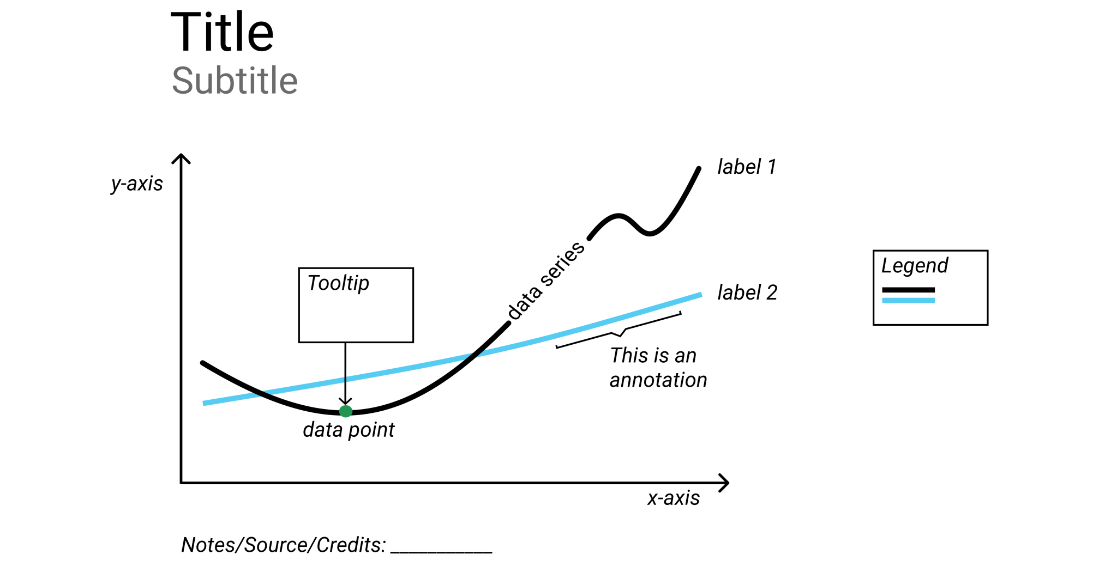
Common chart components
Notes:
https://handsondataviz.org/chart-design.html

Slide 34
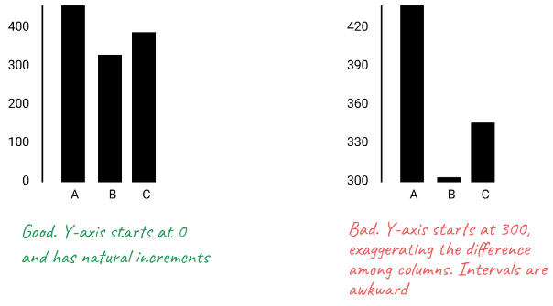
Bar and Column Charts Must Begin at Zero

Slide 35
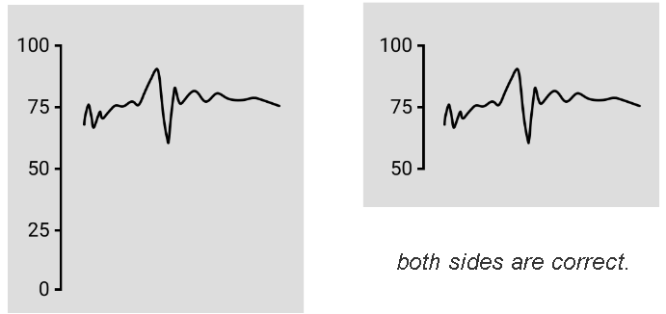
line charts do not require a zero baseline

Slide 36
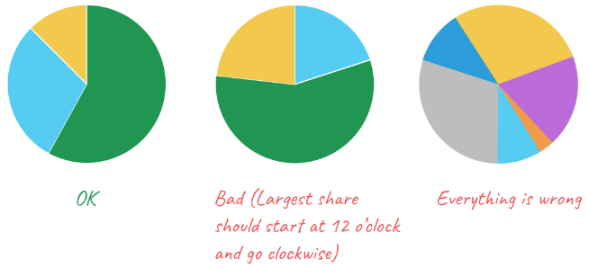
Pie Charts Represent 100%, Arrange slices from largest to smallest, clockwise, and put the largest slice at 12 o’clock.
If your pie chart has more than five slices, consider showing your data in a bar chart.

Slide 37
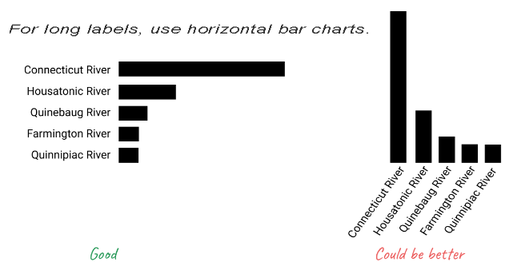
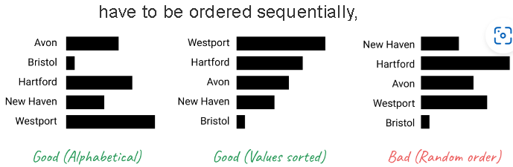

Slide 38
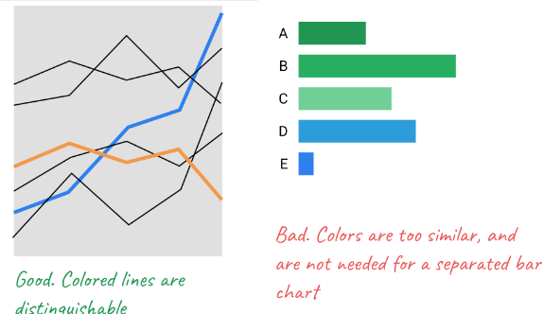

Slide 39
4.2 Examples of Effective Visualizations

Slide 40
Activity
In one minute, sketches the visualization as possible of these two numbers:
20 24

Slide 41
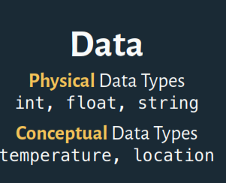
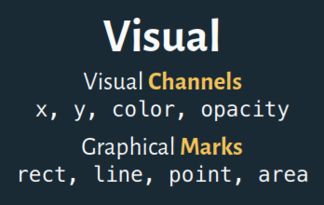

Slide 42
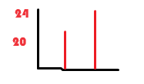
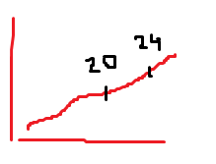
Bar chart
Pie chart
Graph

Slide 43
Evaluating Graphics
“No matter how clever the choice of the information, and no matter how technologically impressive the encoding, a visualization fails if the decoding fails” (Cleveland 1983).
But how do we detect if our encodings have failed? Munzner uses the principles of expressiveness and effectiveness to help us evaluate our data visualizations.

Slide 44
The expressiveness of a visual encoding should “express all of, and only, the attributes of the data.”
It is violated when we use encodings that do not match our data type or our visualization goals.
The effectiveness of a visual encoding addresses how accurately can the interpreter of the chart decode the encodings within it and derive accurate knowledge.

Slide 45
Evaluating Graphics
We need to determine if the visualization actually tells the true story of the data.
To do this, ask yourself these questions:
Data
Do numbers seem too big or too conveniently rounded?
Are the units of measure consistent.
Is the data cherry-picked? Are date ranges or time boundaries specifically chosen because they demonstrate a desired result?

Slide 46
Layout
Is this the best way to visualize this data?
Ask questions of text and labels. Does the title convey a thesis or put forth an argument?
Can you spot emotionally-laden words or is the language neutral and purely descriptive?
What does the color choice tell us? Red usually signals trouble, or at least emphasis.
Is the graphic layout designed to emphasize or deemphasize some of the data?

Slide 47
5. Value of Visualization
Enhances Understanding:
Transforms data into a comprehensible format.
Facilitates quicker insights.
Supports Decision-Making:
Enables informed choices based on insights.
Assists in identifying trends and outliers.
Communicates Complex Information:
Simplifies intricate data for diverse audiences.
Facilitates effective communication.

Slide 48
Value of Visualization
V = T + I + E + C
T = The ability to minimize total time needed to answer a wide variety of questions.
I = The ability to spur and discover insights or insightful questions about the data.
E = Ability to convey an overall essence or take-away sense of the data.
C = Ability to generate confidence and trust about your data its domain and context.
Notes:
https://www.tableau.com/blog/what-value-visualization-31132

Slide 49
6. Data and Image Models
Data models are low-level descriptions
Math: sets with operations on them
Example: integers with + and x operators
A data model is a description of the objects represented by a computer system, together with their properties and relationships;
Images are perceived as a set of signs.
Sender encodes information in signs.
Through visual perception, the receiver decodes the signs for information:
Notes:
https://vis.csail.mit.edu/classes/6.894/lectures/02-DataImageModels.pdf

Slide 50
Relational Data Model
Represent data as a table (relation)
Each row (tuple) represents a record
Each record is a ﬁxed-length tuple
Each column (attribute) represents a variable
Each attribute has a name and a data type
A table’s schema is the set of names and types
A database is a collection of tables (relations)

Slide 51
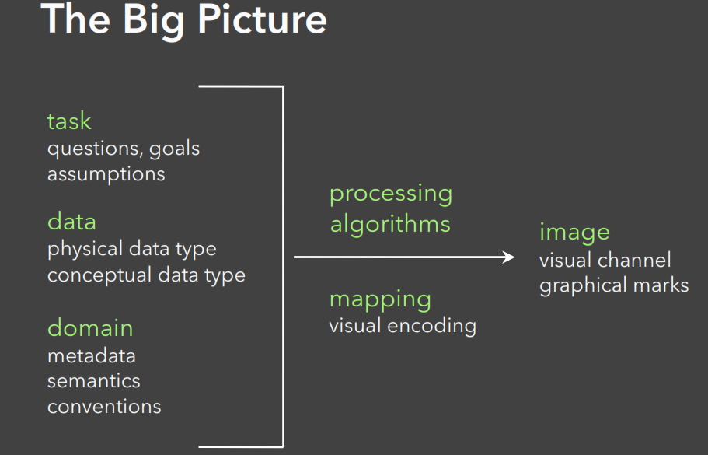

Slide 52
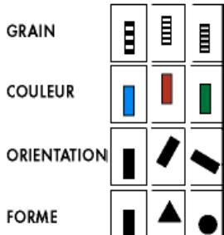
Visual Variables also called visual channels.
Used to encode data values as characteristics of marks.

Slide 53
7. Common tools for creating data visualizations
IBM® SPSS®
R
Tableau
Excel

Slide 54
IBM® SPSS®
IBM® SPSS® Statistics is a powerful statistical software platform.
It offers a user-friendly interface and a robust set of features
Lets your organization quickly extract actionable insights from your data.
Advanced statistical procedures help ensure high accuracy and quality decision making.
All facets of the analytics lifecycle are included, from data preparation and management to analysis and reporting.

Slide 55
R
R is an open source tool.
It is used by the Data Scientists for developing statistical software and data analysis.
R is a GNU project which is similar to the S language.
R is best for data Science because it gives a broad variety of statistical operations.

Slide 56
Tableau
The basic idea behind the development of Tableau software was to make spreadsheets, charts and dashboards that could be easily interacted by using GUIs.
One can also navigate and visualize the data easily.

Slide 57
Excel
Microsoft Excel is a tool used for developing spreadsheets.
Using Excel, you can perform calculations on the data, data graphing, create pivot tables, etc.
If we compare excel with R and Tableau, Excel might seem outdated.
Also, it’s said that it is still quite popular for two reasons:
accessibility
usability

Slide 58
Excel vs SPSS vs R vs Tableau
Excel: A spreadsheet software that can perform statistical analysis.
Excel is better for basic analysis and simple data management.
IBM SPSS: A statistical analysis software that is more powerful than Excel.
SPSS has built-in data manipulation tools, such as recording and transforming variables.
R: A programming language and environment for statistical computing and graphics.
R is an interpreted language that users can access through a command-line interpreter.
Tableau: A cloud-hosted analytics platform that helps users publish dashboards and share discoveries.
Tableau is for data visualization and business intelligence. It offers powerful visualization capabilities and handles large data sets more efficiently.

Slide 59


